Slide 1
Heuristically Optimized Trade-offs: A New Paradigm for Power Law in Internet
CS591 Graph Theory Final Project Presentation
Lu Min

Slide 2
Outline
Problem Definition
Model
Results
Experiments
Conclusion & Future Work

Slide 3
Outline
Problem Definition
Model
Results
Experiments
Conclusion & Future Work

Slide 4
Problem Definition
The project proposes a plausible explanation of power law distribution of degrees observed in the graphs arising in the internet topology based on a toy model of internet growth in which two objectives are optimized simultaneously: “last mile” connection costs, and transmission delays measured in hops.
This project proposes a simple and primitive model of internet growth, and prove that, under very general assumptions and parameter values, it results in power-law-distributed degrees.

Slide 5
Outline
Problem Definition
Model
Results
Experiments
Conclusion & Future Work

Slide 6

Model
In the model a tree is built as nodes arrive uniformly at random in the unit square. When the $i$-th node arrives, it attaches itself on one of the previous nodes.
Which one? ------ Euclidean distance
But a newly arrived node plausibly also wants to connect to a node in the tree that is “centrally located”, that is, its hop distance to the other nodes is as small as possible. The former objective captures the “last mile” costs, the latter the operation costs due to communication delays.
Optimization of the highly optimized tolerance (HOT) model.

Slide 7

Model
Thus, node $i$ attaches itself to the node $j$ that minimizes the weighted sum of two objectives:
$$\min_{j<i}α∙d_{ij}+h_{j}$$

Slide 8
Outline
Problem Definition
Model
Results
Experiments
Conclusion & Future Work

Slide 9
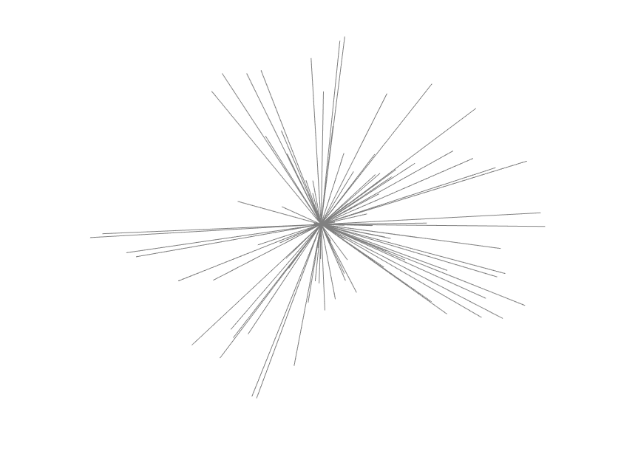
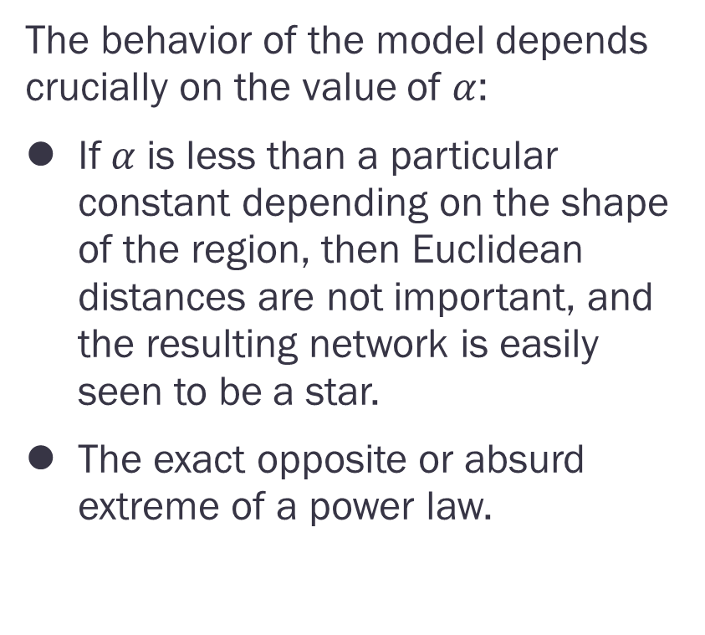
Results
The behavior of the model depends crucially on the value of $α$:
If$α$ is less than a particular constant depending on the shape of the region, then Euclidean distances are not important, and the resulting network is easily seen to be a star.
The exact opposite or absurd extreme of a power law.
Figure 1

Slide 10
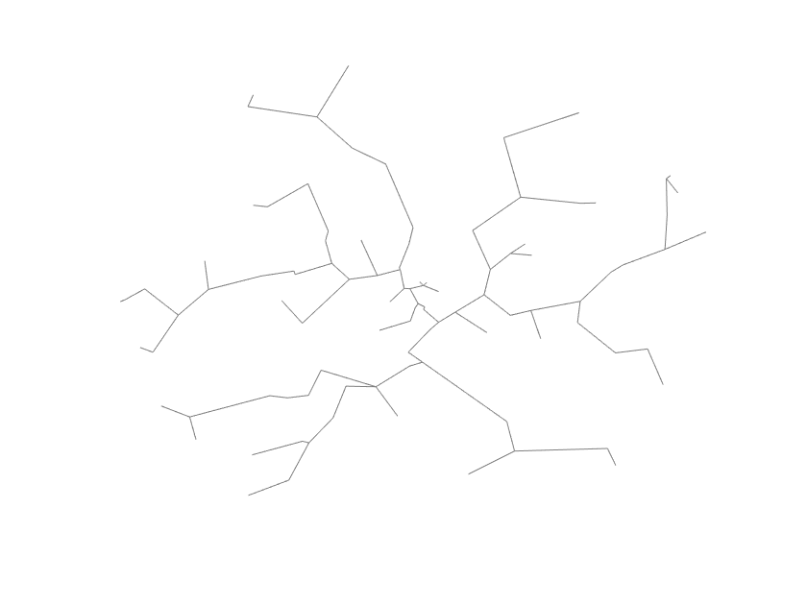
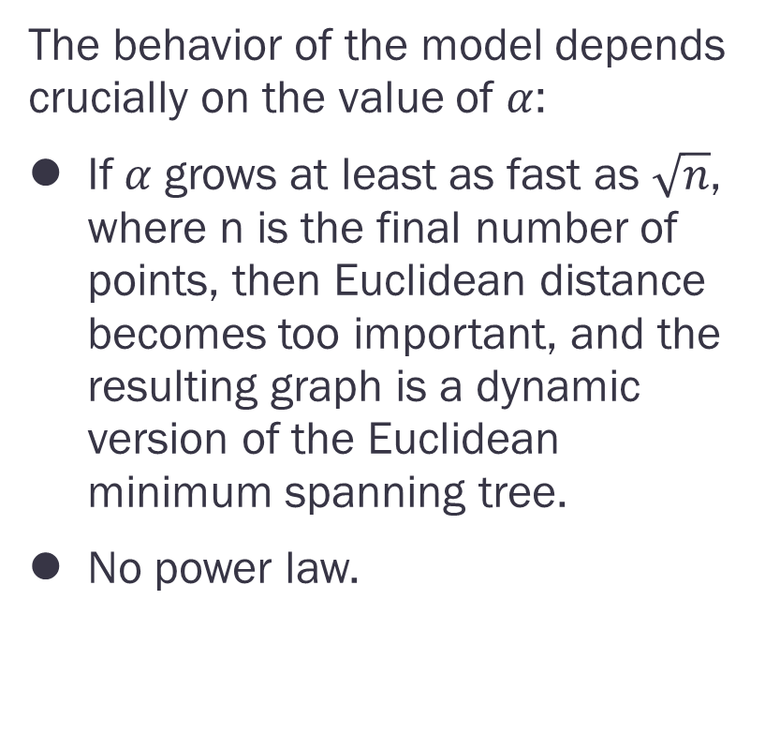
Results
The behavior of the model depends crucially on the value of $α$:
If$α$ grows at least as fast as $\sqrt{n}$, where n is the final number of points, then Euclidean distance becomes too important, and the resulting graph is a dynamic version of the Euclidean minimum spanning tree.
No power law.
Figure 2

Slide 11
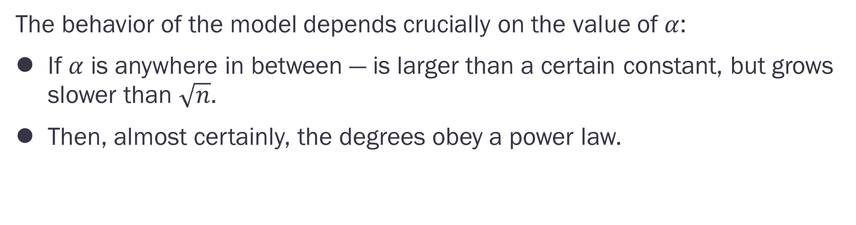
Results
The behavior of the model depends crucially on the value of $α$:
If $α$ is anywhere in between — is larger than a certain constant, but grows slower than $\sqrt{n}$.
Then, almost certainly, the degrees obey a power law.

Slide 12
Outline
Problem Definition
Model
Results
Experiments
Conclusion & Future Work

Slide 13
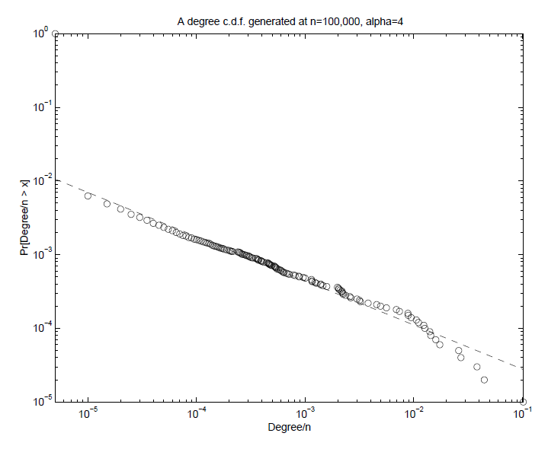
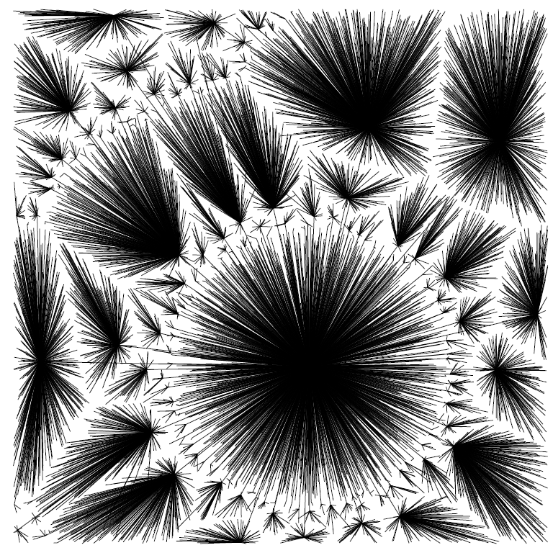
Experiments
Figure 3 c.d.f and the associated tree generated for $α=4$ and $n=100,000$ (only the first 10,000 nodes are shown)

Slide 14
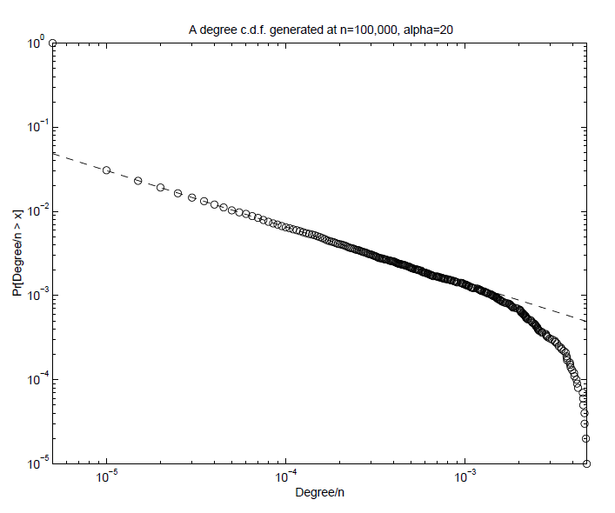
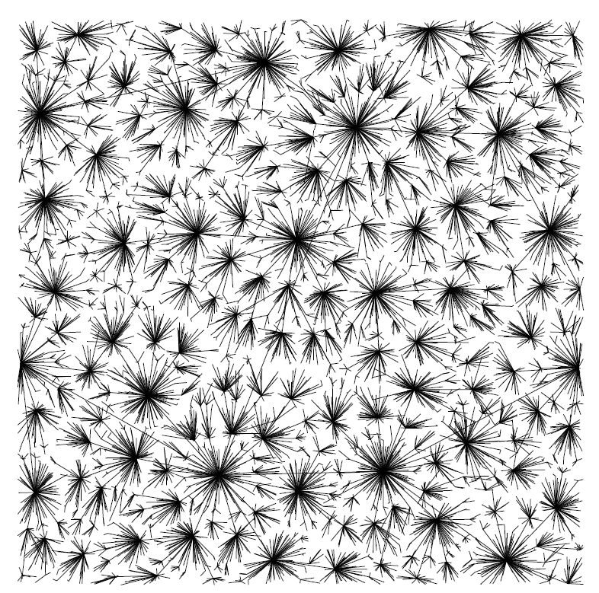
Experiments
Figure 3 c.d.f and the associated tree generated for $α=20$ and $n=100,000$ (only the first 10,000 nodes are shown)

Slide 15
Outline
Problem Definition
Model
Results
Experiments
Conclusion & Future Work

Slide 16
Conclusion & Future Work
As in the HOT model, power laws are seen to fall off as a by-product of resource optimization. However, only local optimizations are now needed, instead of global optimizations. This makes the heuristically optimized tradeoffs model very appealing.
However, this model only generates graphs of density 1. This also implies that the graph is actually a tree, whereas many real-world graphs have cycles. Also, in addition to the degree distribution, the generated graphs need to be analyzed for all other graph patterns too. Further research needs to modify the basic model to address these issues.

Slide 17
Future Work
In the paper, it also establish a model of file creation.
Suppose that we are given n positive real numbers p1, . . . , pn, intuitively capturing the “popularity” of n data items, the expected number of times each will be retrieved. We wish to find a partition of the items into and minimize.

